Slide 1
Converting Validated Scales into Consolidated Electronic Case Report Forms (eCRFs)
Katie Jentoft
Clinical Data Manager

Slide 2
Validated Scales
Objectively measure cognition, behavior, or other traits
Baseline status
Change over time

Slide 3
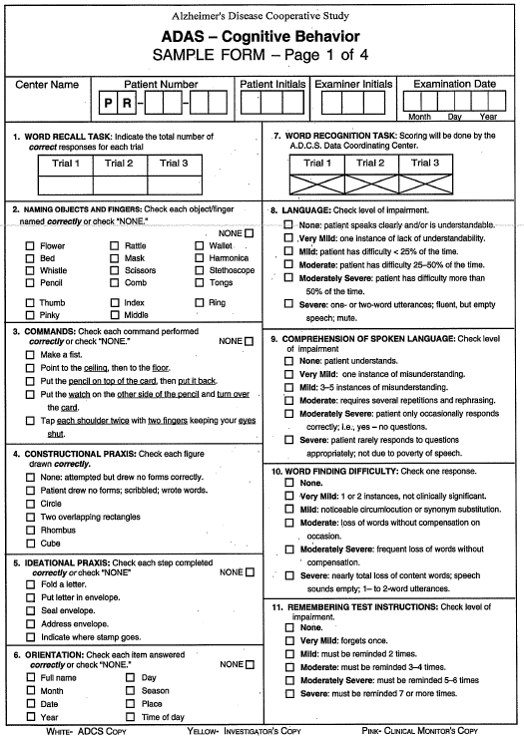
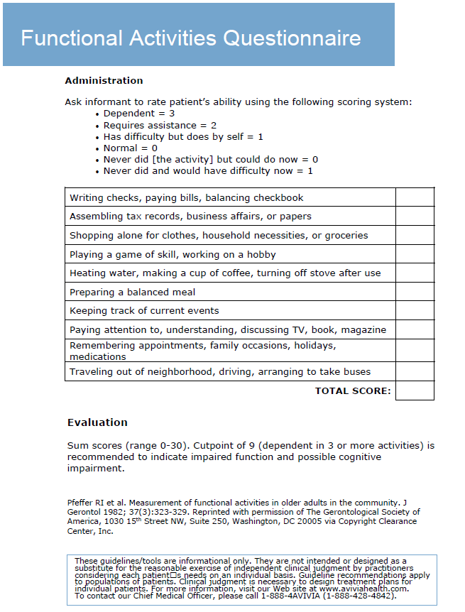
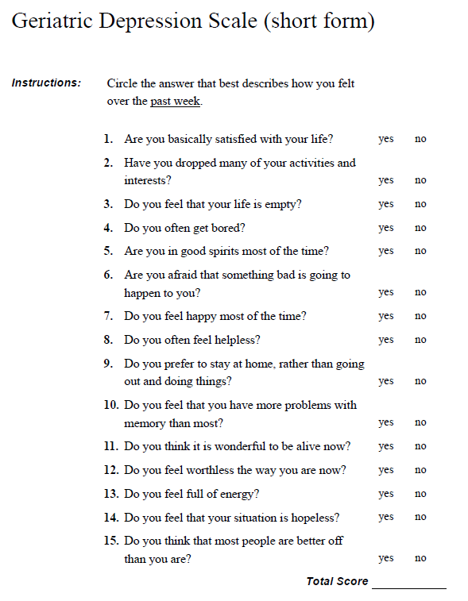
Notes:
Examples of validated scales in Alzheimer’s research

Slide 4
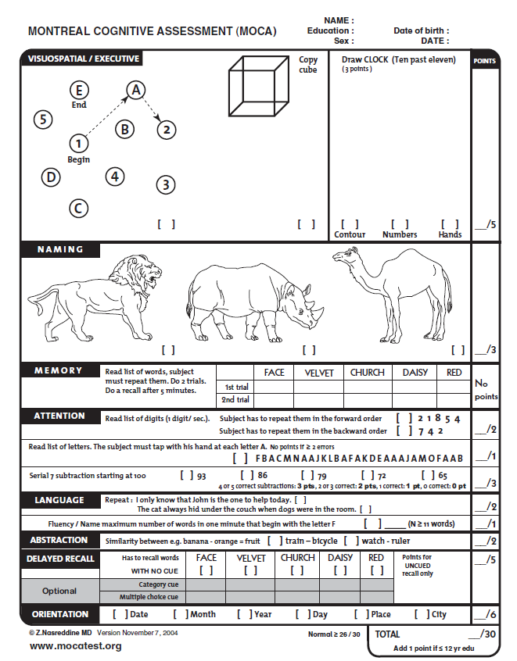

Slide 5
Validated Scale → eCRF
What is the best way to capture data electronically?
Goals
Collect essential data points
Enable data analysis

Slide 6
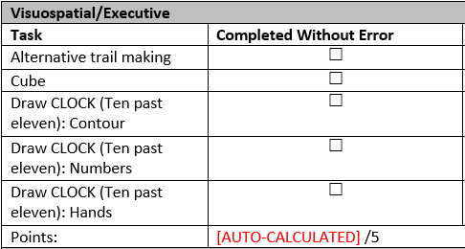
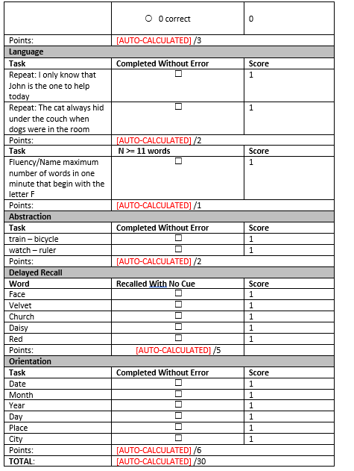
Verbatim Legacy Forms

Slide 7
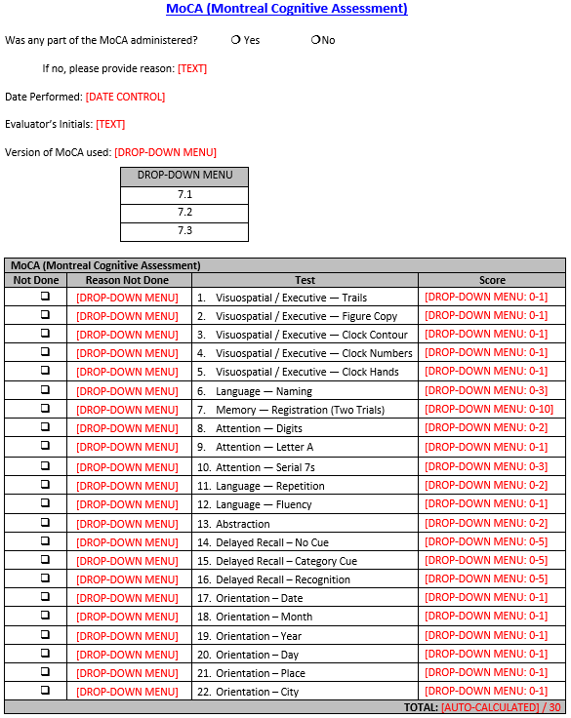
Consolidated eCRFs

Slide 8
Consolidated eCRF Process
Identify essential data points
Follow Good Clinical Data Management Practices (GCDMP)
Incorporate Clinical Data Acquisition Standards Harmonization (CDASH)
Simplify design

Slide 9
Montreal Cognitive Assessment (MoCA)

Slide 10
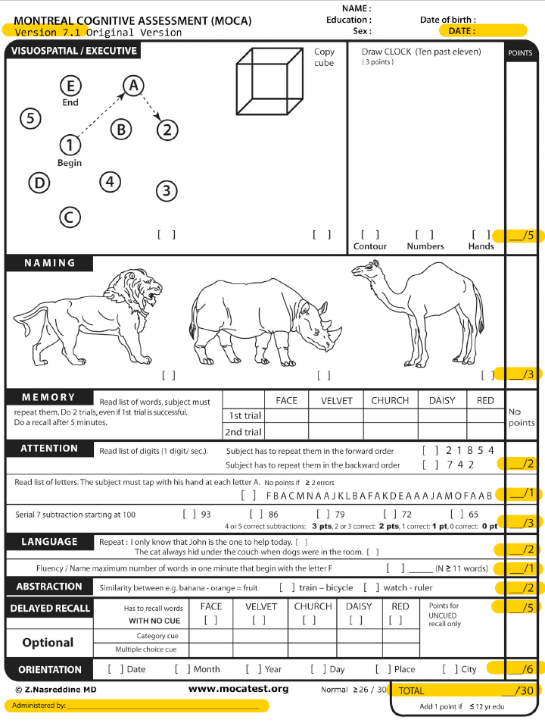
1. MoCA Essential
Data Points
Date
Evaluator
MoCA version
Section scores
Total score

Slide 11
2. MoCA GCDMP
Formatting
Multidisciplinary input
Licensing
Standards

Slide 12
3. MoCA CDASH
Every question requires a response
Common fields in the same place on every eCRF
Limit free text fields

Slide 13
4. MoCA Design
Single table
Drop-down menus
Auto-calculations

Slide 14
MoCA Consolidated eCRF

Slide 15
Consolidated eCRF Benefits
Validation
User interface
Data cleaning
Final analysis

Slide 17
Thank you!
Katie Jentoft
kjentoft@mgh.harvard.edu
617-643-3404

Slide 18
Reference List
ADAS-Cognitive Behavior Sample Form. MemoryWorks website. http://memoryworks.org/screening/ADAS/ADAS_Packet.pdf. Accessed May 15, 2019.
Functional Activities Questionnaire. FPInfo: Resources to support patient care website. https://www.healthcare.uiowa.edu/familymedicine/fpinfo/docs/functional-activities-assessment-tool.pdf. Accessed May 15, 2019.
Geriatric Depression Scale (short form). Geriatric Examination Tool Kit website. https://geriatrictoolkit.missouri.edu/cog/GDS_SHORT_FORM.PDF. Accessed May 15, 2019.
Montreal Cognitive Assessment (MOCA). MoCA Montreal - Cognitive Assessment website. https://www.mocatest.org/wp-content/uploads/2015/tests-instructions/MoCA-Test-English_7_1.pdf. Accessed May 15, 2019.
President Trump Official Portrait. White House website. https://www.whitehouse.gov/wp-content/uploads/2017/11/President-Trump-Official-Portrait.jpg. Accessed May 15, 2019.
Good Clinical Data Management Practices (GCDMP). Society for Clinical Data Management website. https://www.scdm.org/publications/gcdmp/. Accessed May 15, 2019.
Clinical Data Acquisition Standards Harmonization (CDASH). Clinical Data Interchange Standards Consortium website. https://www.cdisc.org/standards/foundational/cdash. Accessed May 15, 2019.

